Slide 1
Bayesian BELIEF NETWORKS Dr. Farhan hassan khan
MACHINE LEARNING

Slide 2
Bayesian Belief Networks
Bayesian belief network allows a subset of the variables conditionally independent
A graphical model of causal relationships; directed acyclic graph
Represents dependency among the variables
Gives a specification of joint probability distribution
Nodes: random variables
Links: dependency
X and Y are the parents of Z, and Y is the parent of P
No dependency between Z and P
Has no loops or cycles
X
Y
Z
P

Slide 3
Bayesian Belief Network: An Example
The conditional probability table (CPT) for variable LungCancer:
Family
History
Smoker
(FH, S)
(FH, ~S)
(~FH, S)
(~FH, ~S)
LC
0.8
0.5
0.7
0.1
~LC
0.2
0.5
0.3
0.9
LungCancer
Emphysema
CPT shows the conditional probability for each possible combination of its parents
The values mentioned above are neither calculated nor computed. They are observed values
Derivation of the probability of a particular combination of values of X, from CPT:
PositiveXRay
Dyspnea
Bayesian Belief Networks

Slide 4
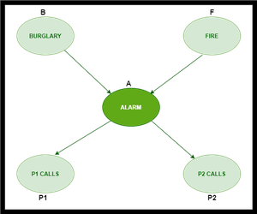
Bayesian Belief Network: An Example
We have an alarm ‘A’ installed in a house of a person ‘Mike’, which rings upon two probabilities i.e. robbery burglary ‘B’ and fire ‘F’, which are – parent nodes of the alarm node.
The alarm is the parent node of two probabilities
Person P1 calls Mike ‘P1’
Person P2 calls Mike ‘P2’.

Slide 5
Bayesian Belief Network: An Example
Upon the instance of robbery and fire, ‘P1’ and ‘P2’ call person Mike, respectively. But, there are few drawbacks in this case,
As sometimes ‘P1’ may forget to call the Mike, even after hearing the alarm, as he has a tendency to forget things, quick.
Similarly, ‘P2’, sometimes fails to call Mike, as he is only able to hear the alarm, from a certain distance.
Question) Find the probability that P1 and P2 both have called Mike when the alarm ‘A’ rang, but no burglary ‘B’ and fire ‘F’ has occurred.

Slide 6
Bayesian Belief Network: An Example
Burglary
True | 0.001
False | 0.999
Fire
True | 0.002
False | 0.998
Alarm
B | F | A=T | A=F
T | T | 0.95 | 0.05
T | F | 0.94 | 0.06
F | T | 0.29 | 0.71
F | F | 0.001 | 0.999
P1
A | P1=T | P1=F
T | 0.95 | 0.05
F | 0.05 | 0.95
P2
A | P2=T | P2=F
T | 0.80 | 0.20
F | 0.01 | 0.99

Slide 7
Bayesian Belief Network: An Example
Question) Find the probability that P1 and P2 both have called Mike when the alarm ‘A’ rang, but no burglary ‘B’ and fire ‘F’ has occurred.
Solution
With respect to the question — P ( P1, P2, A, ~B, ~F) ,
To get the probability of ‘P1’, find it with regard to its parent A.
To get the probability of ‘P2’, find it with regard to its parent A.
Find the probability of alarm ‘A’ node with regard to ‘~B’ & ‘~F’ since burglary ‘B’ and fire ‘F’ are parent nodes of alarm ‘A’.
P ( P1, P2, A, ~B, ~F)
= P (P1 | A) * P (P2 | A) * P (A | ~B~F) * P (~B) * P (~F)
= 0.95 * 0.80 * 0.001 * 0.999 * 0.998
= 0.00075

Slide 8
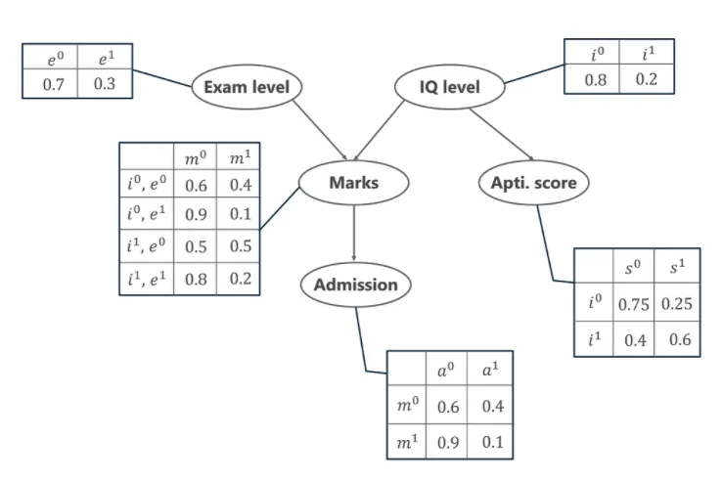
Bayesian Belief Network: Example 2

Slide 9
Bayesian Belief Network: Example 2
In this example, let us imagine that we are given the task of modeling a student’s marks (m) for an exam he has just given.
The marks depend upon two other variables.
Exam Level (e)– This discrete variable denotes the difficulty of the exam and has two values (0 for easy and 1 for difficult)
IQ Level (i) – This represents the Intelligence Quotient level of the student and is also discrete in nature having two values (0 for low and 1 for high)
IQ level also leads us to another variable, which is the Aptitude Score of the student (s).
The probability distribution for getting admitted (a) to a university is also given.

Slide 10
Bayesian Belief Network: Example 2
All the possible events that are occurring in the above-given table.
Exam Level (e)
IQ Level (i)
Aptitude Score (s)
Marks (m)
Admission (a)

Slide 11
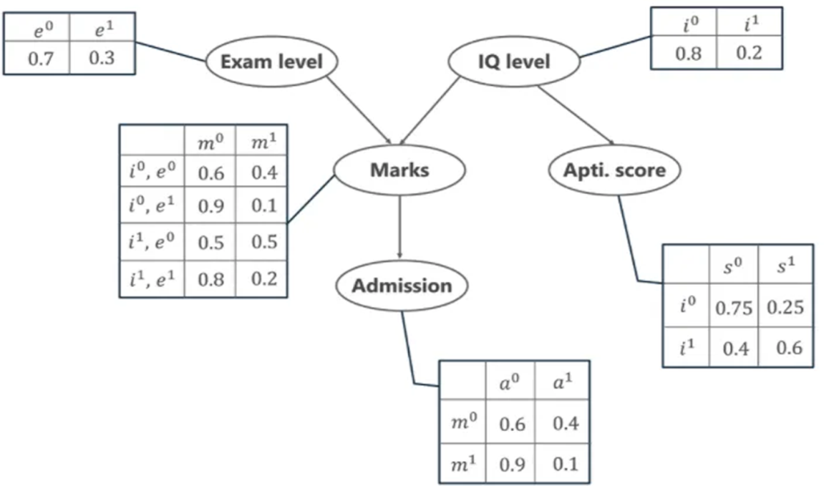
Questions
Question 1
Calculate the probability that in spite of the exam level being difficult, the student having a low IQ level and a low Aptitude Score, manages to pass the exam and secure admission to the university.
Question 2
Calculate the probability that the student has a High IQ level and Aptitude Score, the exam being easy yet fails to pass and does not secure admission to the university

Slide 12
Case 1
Calculate the probability that in spite of the exam level being difficult, the student having a low IQ level and a low Aptitude Score, manages to pass the exam and secure admission to the university.

Slide 13
Case 1
Calculate the probability that in spite of the exam level being difficult, the student having a low IQ level and a low Aptitude Score, manages to pass the exam and secure admission to the university.
P (e1, i0, s0, m1, a1)
= P (e1) * P (i0) * P (s0|i0) * P (m1|e1,i0) * P (a1|m1)
= 0.3 * 0.80 * 0.75 * 0.1 * 0.1
= 0.0018

Slide 14
Case 2
Calculate the probability that the student has a High IQ level and Aptitude Score, the exam being easy yet fails to pass and does not secure admission to the university

Slide 15
Case 2
Calculate the probability that the student has a High IQ level and Aptitude Score, the exam being easy yet fails to pass and does not secure admission to the university
P (e0, i1, s1, m0, a0)
= P (e0) * P (i1) * P (s1|i1) * P (m0|e0,i1) * P (a0|m0)
= 0.7 * 0.2 * 0.6 * 0.5 * 0.6
= 0.0252

Slide 16
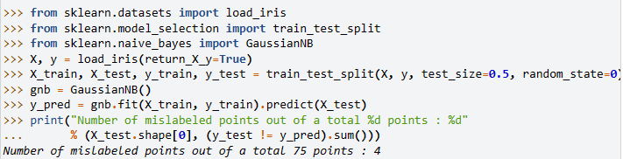
NBC IMPLEMENTATION: PYTHON

Slide 17
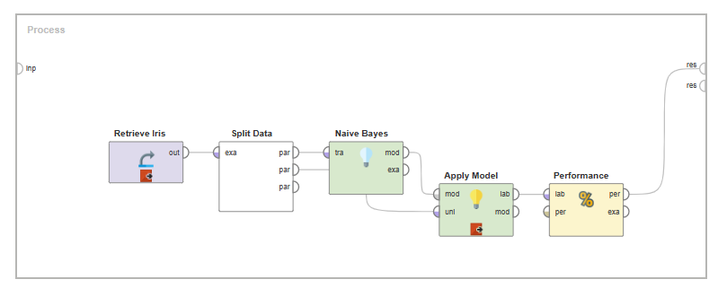
NBC IMPLEMENTATION: RAPID MINER
Naive Bayes - Altair RapidMiner Documentation
(66) Tutorial: How To Perform The Naive Bayes Classifier Algorithm in RapidMiner - YouTube

Slide 18
End of lecture

